Slide 1

Investigating the Factors Influencing the Mental Health Scores of New York City Residents
Confidence Oguebu, Dharva Khambholia, Anesu Gavhera
06 December 2023
Notes:
Confidence
Intro
Dataset mentions columns (
Questions: y = mx + mx +... + c (research questions)

Slide 2
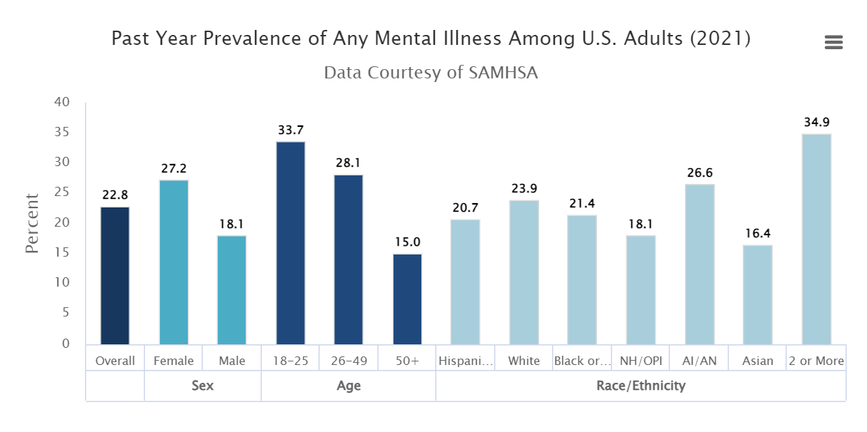
Motivation of research
According to the National Institute of Mental Health. In 2021, there were an estimated 57.8 million adults aged 18 or older in the United States with a mental health illness.. This number represented 22.8% of all U.S. adults, hence the need to critically look into the factors influencing the growing risk of mental health illness.
Notes:
Confidence

Slide 3

Research Question
What are the indicators that affect an individual’s mental health in New York City?
Notes:
Dont change this question anymore!
Confdence

Slide 4
The Survey and Dataset Overview
The New York City Community Health Survey (CHS) is a a cross-sectional telephone survey with an annual sample of randomly selected adults aged 18 and older from all five boroughs of New York City.
Data has 168 columns and Over 8000+ entries.
Data is unbiased and equally sampled across different demographics.
Data made up of categorical, continuous and numerical columns.
Notes:
dharva
Avoided the 8000/10000
A little too wordy but honestly i thinnk its fine

Slide 5
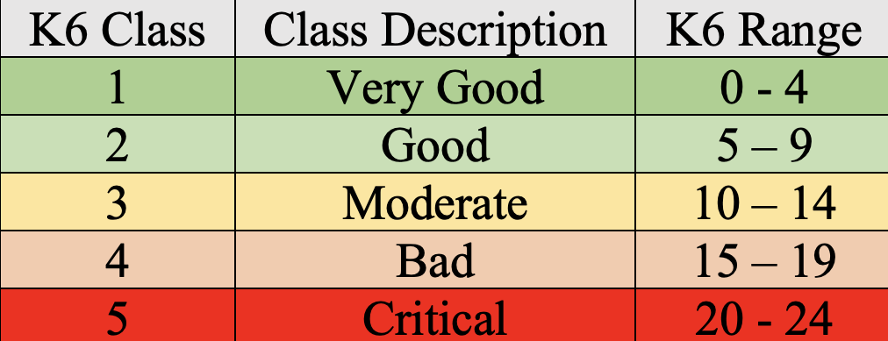
What is K6?
The Kessler Psychological Distress Scale (K6) is a widely used self-report questionnaire designed to measure non-specific psychological distress in individuals. In our dataset, this score is the cumulative of the respondent’s response to 6 different mood questions on the survey (continuous value)
Why Classify K6?
Categorical variables are often more interpretable than continuous ones. For instance, understanding that a person falls into the “Very Good”, or one of the other class categories is more intuitive than interpreting a specific continuous score.
Some classification machine learning algorithms, especially those based on decision trees or rule-based models, can work more effectively with categorical variables. Binning allowed us to leverage these algorithms effectively.
Notes:
Dharva

Slide 6
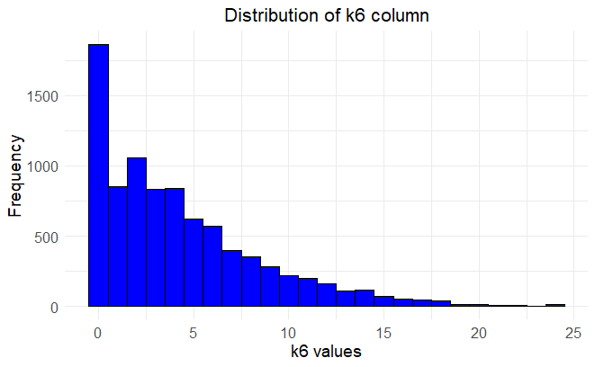
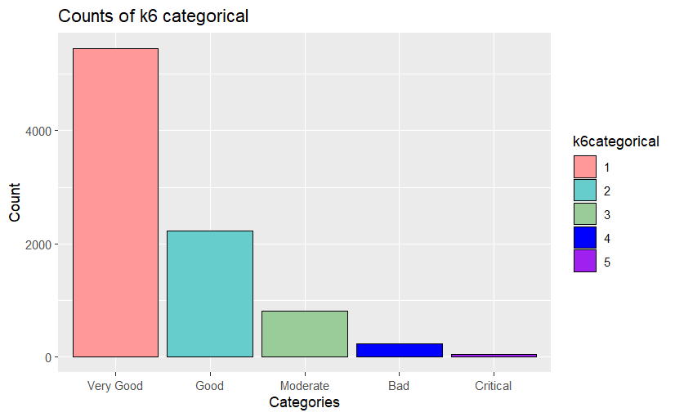
Data Visualizations:
The K6 column represents the mental health score of respondents. This score is the cumulative of a respondent’s response to 6 different mood questions on the survey.
Very Good
Good
Moderate
Bad
Critical
Notes:
Maintain aspect ratio of pics ( count doesnt look nice)
Categorical ranges need to be labelled
dharva

Slide 7
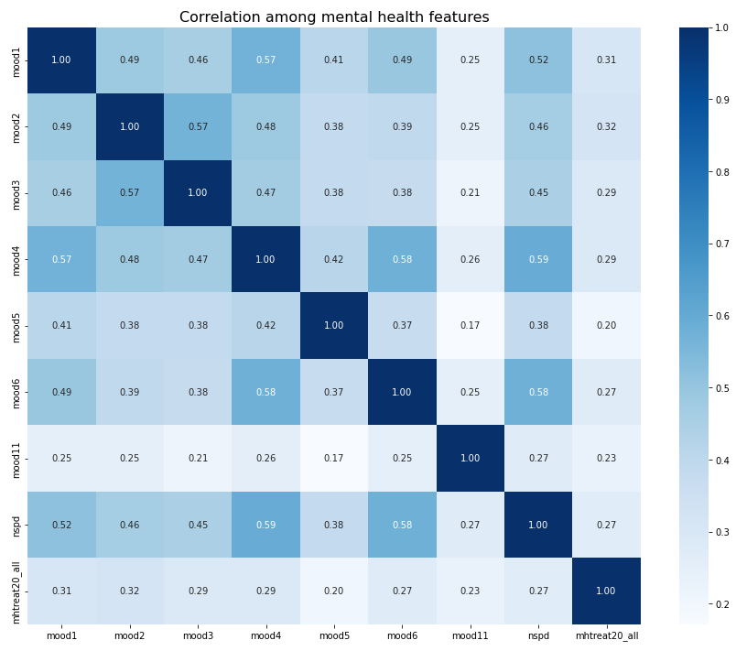
Correlation among several mental health indicators
Notes:
Explain what these moods columns represent during the presentation
\
dharva

Slide 8
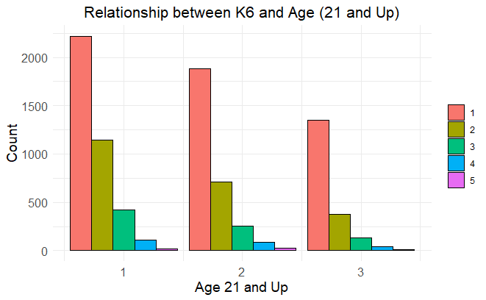
Age Distribution K6:
nbahksbkalhjsblkjbsdasdfasdfadsfasdfasdfads
Distribution of K6 and Age Groups
Very Good
Good
Moderate
Bad
Critical
21 - 44 45 - 64 65+
Notes:
Label these ranges as well
Distribution not rela
Dharva
Very good [0-4]
Good
Moderate
Bad
Critical

Slide 9
Data Pre-processing:
Removal of column variables that consist of more than 5% of missing values
Removal of metadata columns
Data imputation for remaining cols with missing data:
Column median for continuous columns
Column mode for the remaining categorical columns
Classification of k6 scores into 5 classes each of equal interval length
Notes:
Confidence

Slide 10
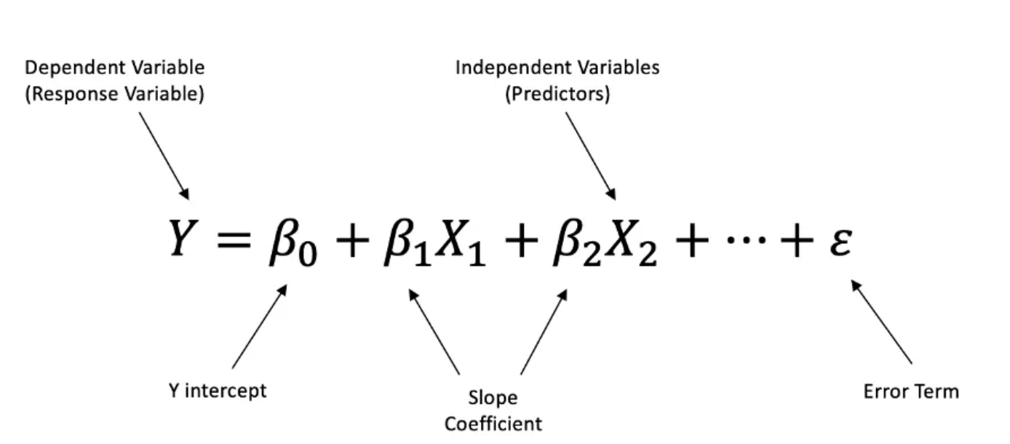
Methodology
Understanding the predictors influencing k6 Score: Feature Selection
In order to achieve this, a backward selection using a simple linear regression model was Implemented to identify the most important predictors influencing k6 score (by considering the p–values of the best-fit regression given by the backward selection)
Using the predictors to Predict k6 Classes
Train/test split using the 80/20 ratio.
Using the predictors from the backward selection to train a ML model on the training data set and use model to predict a respondent’s k6 class.
. Algorithms to be considered:
Logistic Regression
Random Forests
K-Nearest Neighbours
Simple Vector Machines
Note the algorithm with the highest accuracy and use this model to predict k6 score rating of the testing data.
Notes:
Anesu!!!!!!!
Multiple Linear Regressions
After building the model, you can analyze the coefficients of the predictors to determine which ones have a significant impact on the K6 score. Pay attention to the p-values to assess the statistical significance of these predictors.

Slide 11
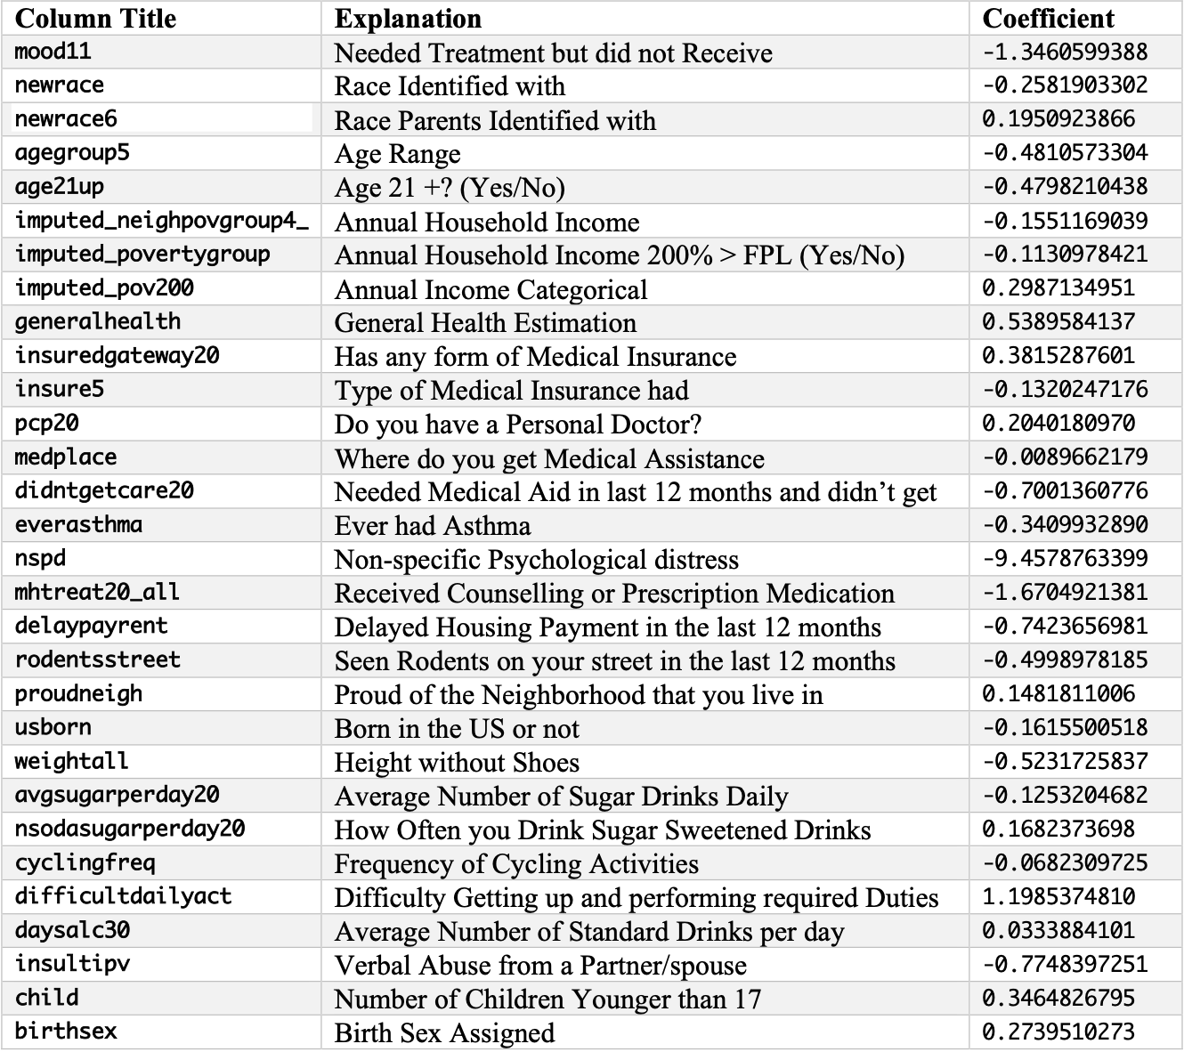
Results from Backward Selection
Only Column Variables with p-values < 0.05 R² = 0.5508
Notes:
Anesu

Slide 12
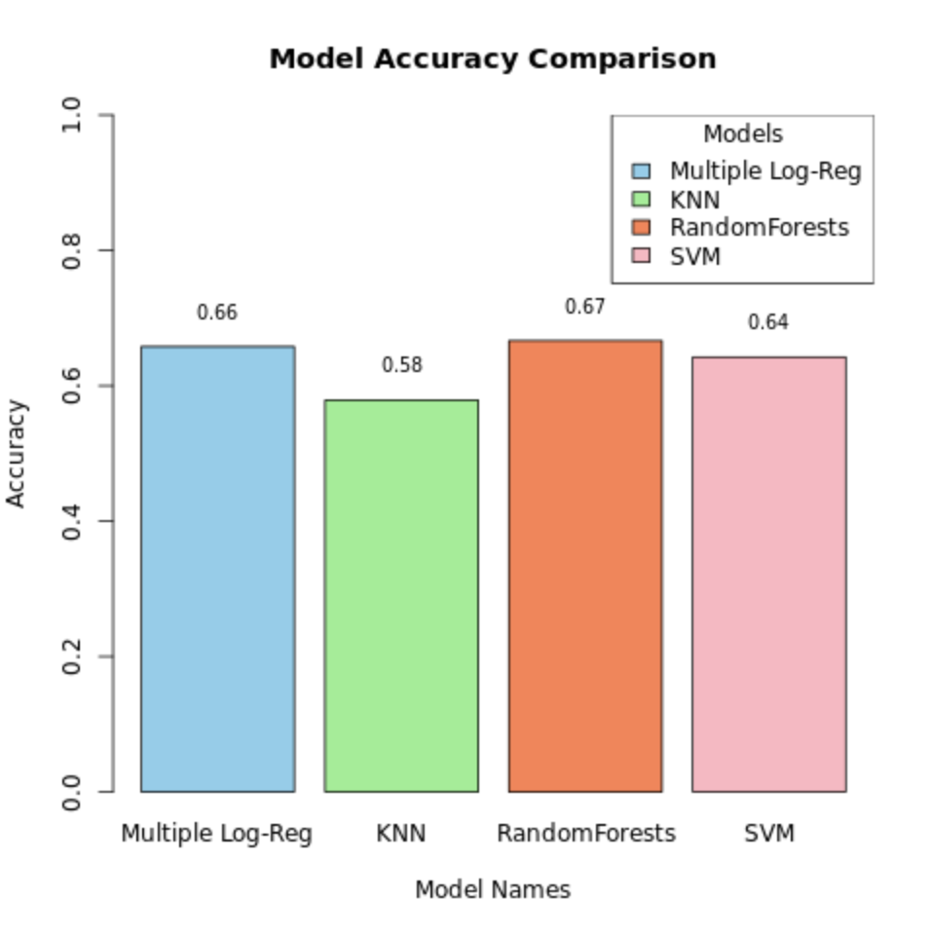
Algorithms Considered
Models were trained using the ‘best features’ from the backward selection to predict the categorical outcome variable K6.
The KNN, Logistic Regression, Random Forest and SVM algorithms were considered. Cross-validation and hyperparameter tuning measures were carried out on the models based on prediction accuracy score to find the best performing model.
Notes:
This slide → dharva

Slide 13
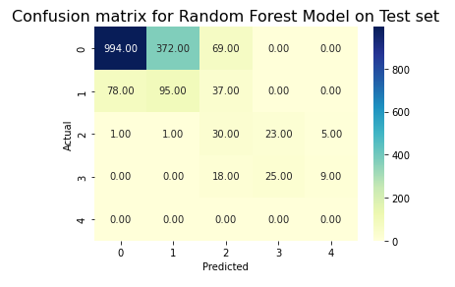
Best Model: Random Forests
The best performing model was the Random Forest model. Tuned some hyper parameters and iterated over several ranges to get the combinations of parameters with the best accuracy.
Optimum Hyper parameters Used:
Ntree → number of trees to grow (200)
Mtry → number of variables to split at each node (4)
Maxdepth → maximum depth of a tree in a forest (5)
Best test accuracy → 0.6585088
Notes:
Confidence
Xis flipped
Model vs accuracy score
Scatterplot:
Confusion matrix:

Slide 14
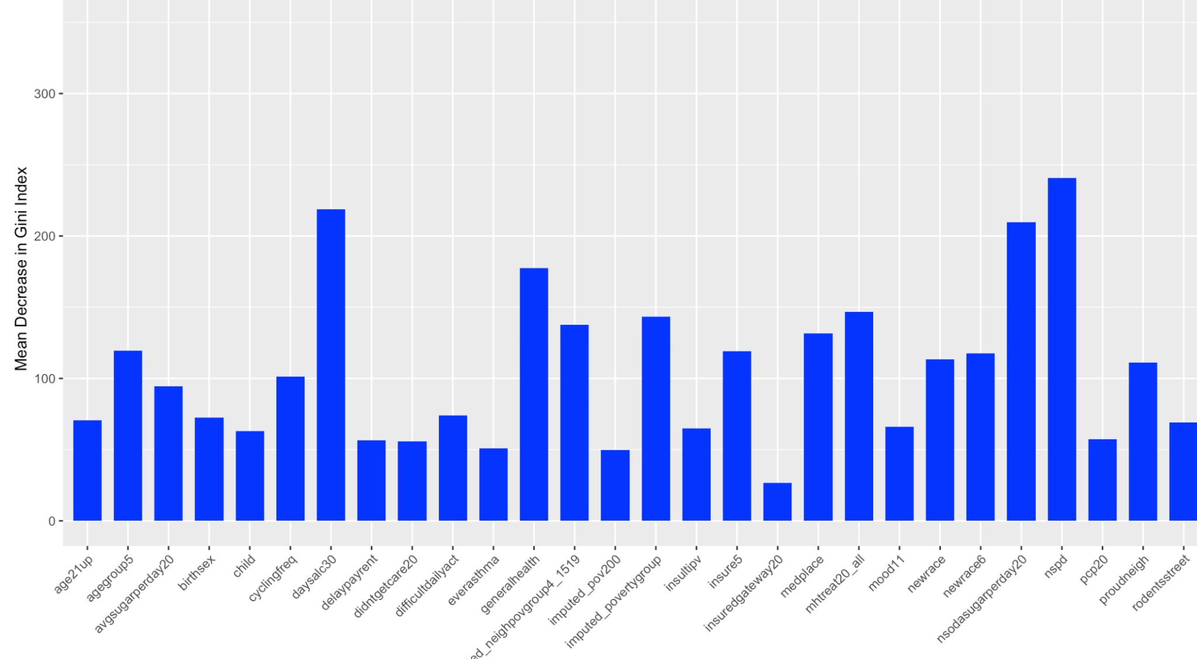
Best Model: Random Forests
Notes:
confidence

Slide 15
Conclusion
The research findings indicate that a higher average daily alcohol intake, elevated poverty levels, respondents with children under 17, frequent consumption of sugar-sweetened drinks, and difficulty getting up to perform required duties are associated with a negative impact on the mental health status of respondents.
On the other hand, positive influences on mental health were identified in individuals who engaged in regular exercise, reported no psychological distress, received appropriate counseling and medical prescriptions, maintained a good height, and possessed medical insurance.
The best model predictive model demonstrated :
a predictive accuracy of ~66% on unseen data > baseline accuracy
an auc score of 0.56
Notes:
Anesu -
In the context of classification, the baseline accuracy is the accuracy that a naive or simple model would achieve. It serves as a reference point for evaluating the performance of more complex and sophisticated models
If your model's accuracy is substantially higher than the random guess baseline, it suggests that your model is capturing meaningful patterns and relationships in the data, and it outperforms a model that predicts classes randomly.
Finalized the column variables that affect the k6 classification
Trained and optimized 4 ML models capable of predicting k6 classification:
with accuracy scores > baseline accuracy
ROC and AUC of best model:
27 magic number
In the context of classification, the baseline accuracy is the accuracy that a naive or simple model would achieve. It serves as a reference point for evaluating the performance of more complex and sophisticated models
If your model's accuracy is substantially higher than the random guess baseline, it suggests that your model is capturing meaningful patterns and relationships in the data, and it outperforms a model that predicts classes randomly.

Slide 16
Limitations
The imputation of null values using column mean and mode might have introduced some bias, distorted variability or impacted some correlations
Additionally, the removal of columns with significant missing values might result in the loss of valuable information and correlations, potentially leading to a biased subset of data.
The selected subset of features (from backward selection) might not be the most informative for predicting the k6 class variable because:
Relevant features may have been discarded during data cleaning
failure to consider all possible combinations of predictor columns (~80) during feature selection
Notes:
Anesu
Given that most of the missing values were not completely at random, removing columns with missing values could introduce bias into the dataset, leading to inaccurate model conclusions.
Instead of removing columns, imputing missing values in a thoughtful way might have allowed you to retain more information. Advanced imputation methods can handle missing data patterns more effectively, providing a more comprehensive representation of the dataset.
Reduced model robustness:
Deleting columns with missing values may result in a less robust model. The model may become more sensitive to outliers, as well as more susceptible to overfitting or underfitting, depending on the amount of data loss and the characteristics of the remaining features.

Slide 17
References
https://www.who.int/health-topics/mental-health#tab=tab_1
https://digital.nhs.uk/blog/transformation-blog/2018/the-past-present-and-future-of-innovation-in-mental-health
https://www.nyc.gov/site/doh/data/data-sets/community-health-survey-methodology.page
https://www.nimh.nih.gov/health/statistics/mental-illness
https://www.nyc.gov/site/doh/data/data-sets/community-health-survey-public-use-data.page
https://www.who.int/health-topics/mental-health
https://search.r-project.org/CRAN/refmans/Rfast2/html/lm.bsreg.html
https://medium.com/swlh/understanding-multiple-linear-regression-e0a93327e960
https://www.who.int/news/item/02-03-2022-covid-19-pandemic-triggers-25-increase-in-prevalence-of-anxiety-and-depression-worldwide

Slide 18


